Slide 1

Persistently Struggling School
Public Forum
September 29, 2016
Presented by
Shaun C. Nelms, Superintendent

Slide 2
Background
Why is East Considered a Persistently Struggling School?
  East High School is an “Out of Time” school
  Among the lowest achieving public schools in the state for ten consecutive school years
  A “Priority School" for each year from the 2012-13 school year to the current school year

Slide 3
Receivership – Intervention in Struggling Schools
Section 211-f of Education Law establishes a new intervention authority for districts and the Department to turn around struggling schools through receivership.
Persistently
Struggling Schools: Schools
that have been in the most severe accountability status since the 2006-07 school year.
Superintendent is given 1 year with “receivership”
powers to improve performance. School is eligible for state grant to support turnaround efforts.
If the school fails to demonstrate improvement, the school may be placed in Independent Receivership for 3 years.
Struggling Schools: Schools that have been Priority Schools since 2012-13.
If the school fails to demonstrate improvement in 2 years, the school may be placed in Independent Receivership for 3 years.
Superintendent is given 2 years with “receivership” powers to improve performance.

Slide 4
The Dilemma
NYSED gave the district 5 choices for East for the
2014-15 school year
  Close
  Become a charter school
  Operate under SUNY
  Phase out
  Operate under an Educational Partnership Organization (EPO)

Slide 5
Powers of a Superintendent Receiver
Superintendent Receivers Can:
  Review and make changes to the school budget.
  Create/change school program and curriculum.
  Create an intervention plan for approval by the Commissioner.
  Supersede a decision made by the Board of Education.
  Require all staff to reapply for their positions.
  Implement professional development for staff.
  Expand the school day or year.
  Convert the school to a charter school, pursuant to the law.
  Request changes to the collective bargaining agreement.
  Convert the school to a community school.
Superintendent Receivers Cannot:
  Override the Board of Education regarding hiring decisions for the Superintendent.

Slide 6
“All organizations are perfectly designed to get the results they are now getting. If we want different results, we must change the way we do things”
-Tom Northrup

Slide 7

What's Our Responsibility?

Slide 8


Inspect what you expect…
Where we began…

Slide 9
EAST EPO - Attendance
Currently Enrolled Students with Chronic Attendance Issues in 2014-2015 by Grade
Data retrieved from SPA on 8.11.15
Grade | Enrolled | Chronic AB | %
Grade 6 | 82 | 7 | 8.5%
Grade 7 | 156 | 16 | 10.3%
Grade 8 | 204 | 95 | 46.6%
Grade | Enrolled | Chronic AB | %
Grade 9 | 438 | 261 | 59.6%
Grade 10 | 275 | 104 | 37.8%
Grade 11 | 206 | 56 | 27.2%
Grade 12 | 168 | 47 | 28.0%
*Chronic means attended school less than 80% of the time.

Slide 10
Total Cohort Data
Graduation Predictions:
Graduated and active scholars who have passed 5 or more Regents Exams with a 65 and higher and have 16 or more credits = 61/268 = 22.76%
Graduated and active scholars who have passed at least 3 Regents with a 65 and higher and have 16 or more credits = 99/268 =
36.94%
Graduated and active scholars who have 16 or more credits = 127/268 =
47.39%
Regents Score Status
–
2012 Total Cohort (268 students)
Sco
red 65
-
100 or EX
Scored 55
-
64
Scored 0
-
Regents
54
Not Taken
(n)
%
(n)
%
(n)
%
(n)
%
Math
138
51.5%
41
15.3%
38
14.2%
50
18.7%
English
99
36.9%
25
9.3%
48
17.9%
95
35.4%
Science
112
41.8%
27
10.1%
29
10.8%
99
36.9%
Global
71
26.5%
29
10.8%
43
16.0%
124
46.3%
USHG
99
36.9%
26
9.7%
76
28.4%
66
24.6%
Regents Score Status
–
2012 Active Cohort (157 students)
Scored 65
-
100 or EX
Scored 55
-
64
Scored 0
-
Regents
54
Not Taken
(n)
%
(n)
%
(n)
%
(n)
%
Math
115
73.2%
27
17.2%
12
7.6%
3
1.9%
English
91
58.0%
23
14.6%
33
21.0%
10
6.4%
Science
99
63.1%
22
14.0%
20
12.7%
16
10.2%
66
42.0%
26
16.6%
38
24.2%
27
17.2%
Global
USHG
88
56.1%
19
12.1%
38
24.2%
12
7.6%
East Grad Rate (2015) 33.3%

Slide 11
SWD - Graduation Data by Program
(Past 4 Graduating Cohorts)
Past 4 Graduating Cohorts |  | Graduates |  |  |  | Non-Completers
Total SWD Enrollment: 221 | Enrollment | IEP Diploma | Local Diploma | Commencement Credentials | Regents | Dropped Out | Still Enrolled
Self-Contained | 85 | 2.4% | 8.2% | 16.5% | 2.4% | 58.8% | 11.8%
12.1.4 (NYSAA) | 9 | 22.2% | 0.0% | 22.2% | 0.0% | 11.1% | 44.4%
ICOT | 96 | 1.0% | 33.3% | 5.2% | 4.2% | 47.9% | 8.3%
Resource | 13 | 0.0% | 15.4% | 0.0% | 7.7% | 53.8% | 23.1%
CT | 17 | 0.0% | 23.5% | 0.0% | 5.9% | 41.2% | 29.4%
*Self-Contained includes 12:1:1, 8:1:1, 8:1:2, 6:1:1

Slide 12
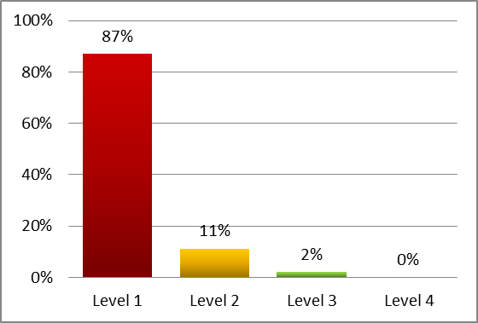
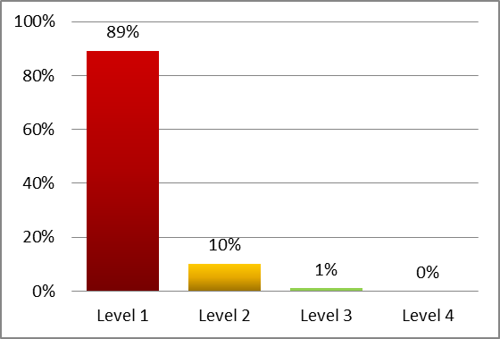
2014-2015 NYS 7-8 ELA and Math Assessment Results
Data retrieved from NYSED on 8.23.15
*Grade 6 not represented here because East did not have Grade 6 in the 2014-2015 school year.
 | NYS 7-8 ELA |  |  |  |  |  |  |  | NYS 7-8 Math
Subgroups | Level 1 |  | Level 2 |  | Level 3 |  | Level 4 |  | Level 1 |  | Level 2 |  | Level 3 |  | Level 4
All Students | 308 | 87% | 39 | 11% | 8 | 2% | 0 | 0% | 291 | 89% | 32 | 10% | 3 | 1% | 0 | 0%
Female | 161 | 89% | 16 | 9% | 3 | 2% | 0 | 0% | 146 | 91% | 14 | 9% | 1 | 1% | 0 | 0%
Male | 147 | 84% | 23 | 13% | 5 | 3% | 0 | 0% | 145 | 88% | 18 | 11% | 2 | 1% | 0 | 0%
Black or African American | 169 | 88% | 19 | 10% | 4 | 2% | 0 | 0% | 142 | 90% | 15 | 10% | 0 | 0% | 0 | 0%
Hispanic or Latino | 96 | 87% | 11 | 10% | 3 | 3% | 0 | 0% | 107 | 90% | 12 | 10% | 0 | 0% | 0 | 0%
White | 29 | 81% | 7 | 19% | 0 | 0% | 0 | 0% | 29 | 88% | 3 | 9% | 1 | 3% | 0 | 0%
General-Ed Students | 243 | 84% | 37 | 13% | 8 | 3% | 0 | 0% | 223 | 87% | 30 | 12% | 3 | 1% | 0 | 0%
Students with Disabilities | 65 | 97% | 2 | 3% | 0 | 0% | 0 | 0% | 68 | 97% | 2 | 3% | 0 | 0% | 0 | 0%
English Proficient | 249 | 84% | 38 | 13% | 8 | 3% | 0 | 0% | 213 | 87% | 29 | 12% | 2 | 1% | 0 | 0%
Limited English Proficient | 59 | 98% | 1 | 2% | 0 | 0% | 0 | 0% | 78 | 95% | 3 | 4% | 1 | 1% | 0 | 0%
Not Economically Disadv. | 15 | 71% | 4 | 19% | 2 | 19% | 0 | 0% | 12 | 75% | 4 | 25% | 0 | 0% | 0 | 0%
Economically Disadv. | 293 | 88% | 35 | 10% | 6 | 2% | 0 | 0% | 279 | 90% | 28 | 9% | 3 | 1% | 0 | 0%

Slide 13
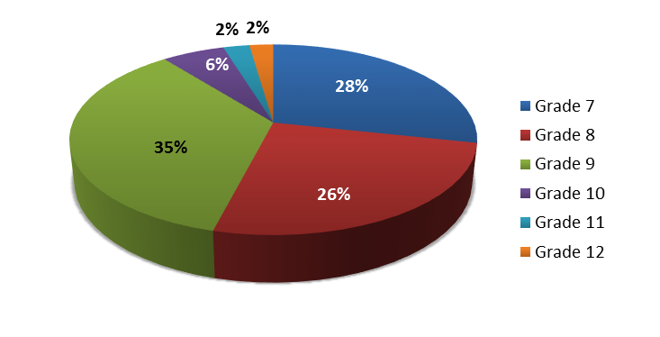
EAST EPO – Discipline Data
Grade | Total Enrollment | Total Suspensions
Grade 6 | 0 | n/a
Grade 7 | 288 | 745
Grade 8 | 291 | 671
Grade 9 | 591 | 928
Grade 10 | 344 | 155
Grade 11 | 216 | 65
Grade 12 | 214 | 59
2014-2015 Suspensions at East Details by Grade
Data retrieved from RCSD Data Management Department on 8.17.15
Grade | never suspended in 14-15 |  | suspended at least once in 14-15 |  | 1 Time |  | 2 Times |  | 3 Times |  | 4 Times |  | 5 or More Times
 | (n) | % | (n) | % | (n) | % | (n) | % | (n) | % | (n) | % | (n) | %
Grade 7 | 162 | 56% | 126 | 44% | 29 | 10% | 19 | 7% | 18 | 6% | 4 | 1% | 56 | 19%
Grade 8 | 136 | 47% | 155 | 53% | 41 | 14% | 27 | 9% | 18 | 6% | 19 | 7% | 50 | 17%
Grade 9 | 372 | 63% | 219 | 37% | 60 | 10% | 40 | 7% | 19 | 3% | 20 | 3% | 78 | 13%
Grade 10 | 276 | 80% | 68 | 20% | 31 | 9% | 17 | 5% | 9 | 3% | 3 | 1% | 8 | 2%
Grade 11 | 173 | 80% | 43 | 20% | 30 | 14% | 8 | 4% | 1 | 0% | 4 | 2% | 0 | 0%
Grade 12 | 187 | 87% | 27 | 13% | 14 | 7% | 5 | 2% | 4 | 2% | 2 | 1% | 2 | 1%

Slide 14
EAST EPO – Retention Data

Slide 15
Persistently Failing School Systems Require More Capacity
East EPO Plan calls for:
  Redesign and reallocation of systems, structures and roles
  Faculty and staff who are “all in, all the time”
  Expanded time for all students
  Better initial teaching
  Culturally sensitive, engaging curriculum
  Greater opportunities to spiral the curriculum, re-teach and re-learn without remediation

Slide 16


How We Are Changing East
SOCIAL EMOTIONAL
U
P
P
O
R
T

Slide 17

The Right People
We insisted on hiring the staff
People will choose to be here
Who buy into the “all in” approach
Who will take advantage of intensive, ongoing professional learning
We have a learning based Collective Bargaining Agreement (CBA)
Ended up with over 500 applicants

Slide 18

Research Based Best Practice
NYSED developed a rubric for highly effective school practice
Diagnostic Tool for School and District Effectiveness (DTSDE) Tenets
  District Leadership
  School Leadership
  Curriculum
  Teaching
  Social Emotional Support
  School Community Partnerships
  And, we added Student Life

Slide 19

Using Evidence Based Practices (Capacity Building)
High Quality, engaging curriculum, assessment and instructional practices
Attention to informed planning
Implemented with fidelity
Monitored and adjusted using
collaborative professional learning
Based on research and results

Slide 20


Social and Emotional
Developmental Health
Collaborative, restorative practices will build a culture in which students have a voice
Each student will have an adult
advocate and daily interactions
with a school “family”

Slide 21


Slide 22
Engaging Families and the Community
Families are equal partners in a child’s education
We embrace a philosophy of partnership where information, decision-making, power, and responsibility are authentically shared.
Family and Community Engagement (FACE) & Planning Teams
  Parents
  Students
  Community Based Organizations & Agency partners
  U of R/Warner faculty

Slide 23
Community Engagement Team
The CET will review, assess, and report on the implementation of the school’s plan.
The CET’s recommendations must be attached to the school plan and the EPO must attach identify which recommendations were incorporated in the plan and how; as well as, which recommendations were not incorporated in the plan and why.
The district will consult with the CET before proposing to the Commissioner any plan modifications. The CET may hold hearings, which must be arranged by the district, to solicit feedback.
The plan must be provided to the local school board, the Superintendent, and representatives of the collective bargaining units, CET, and elected representatives of the parent teacher association and/or parent association.
The Commissioner will annually consult and cooperate with the district, school staff, and CET in determining whether the school has met its annual goals and in assessing the implementation of the plan.
Upon expiration of the school intervention plan, the Commissioner will consult with the district and CET to determine whether to renew the plan, terminate the contract with the Independent Receiver, or remove the school from designation.

Slide 24


Slide 25




Attendance & Behavior

Slide 26
Average Daily Attendance
2014-15 vs 2015-16
94%
92%
85%
85%
82%
85%
81%
72%
62%
Data retrieved from SPA and PowerSchool 6.30.16.
Data is reflective of scholars by credit attainment – per ASAP Policy
Notes:
Attendance grades 6-8 remain a point of pride at East. We exceed the District’s ADA (Average Daily Attendance) . Grade 9 new represents the first time 9th graders.
Grades 10-12 represent the number of students who have enough credits to be considered 10-12 graders. These data are not reliable because many of the students are under credited in these categories and should not be considered true 10-12th graders

Slide 27
Behavioral Data
2014-15 School Year -vs- 2015-16 School Year
Data retrieved from SPA and PowerSchool 6.30.16.
Notes:
The reduction in suspensions can be correlated with our Restorative Practice procedures and the mentoring (Hillside, IBERO and increased number of social workers and counselors)
The data on the left reflects 2014-15 data and the column on the left represents 2015-16.
The Out of School suspensions 1002 days equaled more than 10,000 days of out school
The 181 out school suspensions has resulted in more students staying in school and in class

Slide 28
Academic Achievement Goal
The EPO plan set out to increase student achievement as measured on NYS cohort assessments by reducing the number of students scoring at level 1 (below basic and thus what is required to perform at their grade level)
by 10% in Year 1.

Slide 29
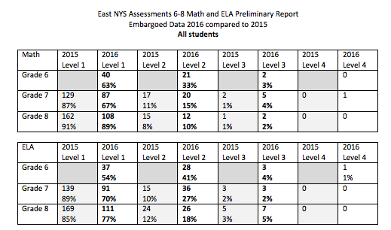
NYS ASSESSMENTS 6-8 Math and ELA
2016-17 SY Compared to 2015-16 SY
Data provided by NYSED

Slide 30





Our End Goal …Contributing Citizens

Slide 31
Demonstrable Improvement
The Commissioner has informed the EAST-EPO that we may have not made demonstrable improvement for the Upper School
The EAST- EPO has provided a Consult and Collaboration document detailing several reasons why we may not have been able to demonstrate demonstrable improvement across both schools
Similar to last year, quarterly, reports will be presented to the state and made available for public review, regarding our progress towards demonstrable improvement

Slide 32
Public Notice & CET Requirements
Community Engagement Team must be able to review the plan and provide feedback and/or recommendations:
  EAST EPO Plan– Summary or Full Proposal
EPO must provide an avenue for feedback in writing and/or electronically
  Let’s Talk! Application
Quarterly reports must be publicly available in the school district’s offices and posted on the school district’s website
  www.rcsdk12.org/east

Slide 33
GREAT THINGS
ARE HAPPENING HERE

